Slide 1
Problems associated with measuring child-adult neural entrainment Methods for measuring child adult neural entrainment

Slide 2
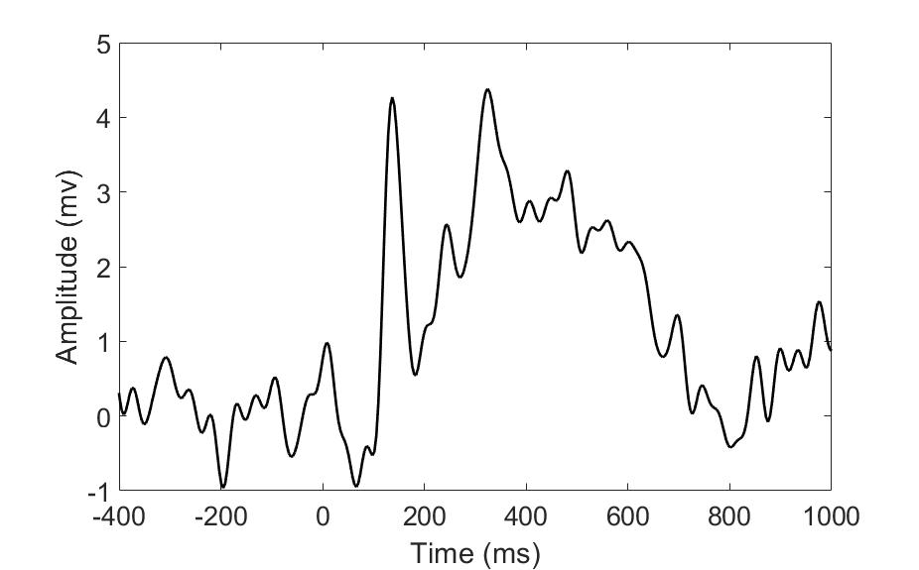
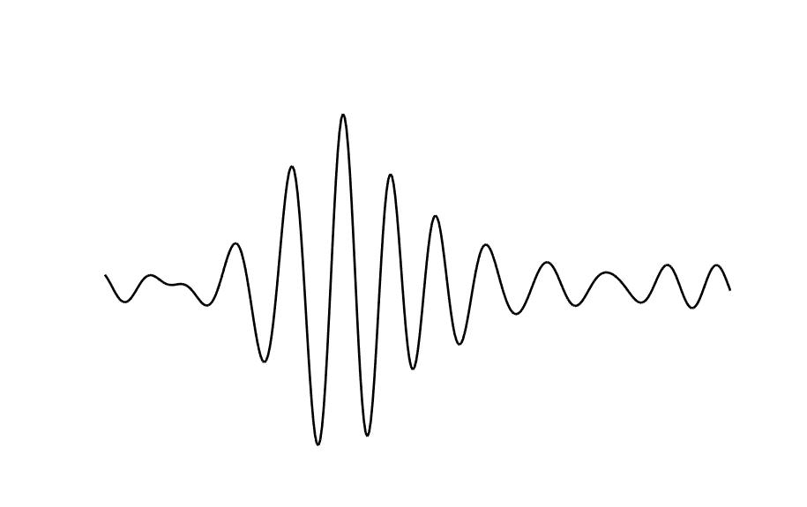
Overview of EEG analysis
Power
How strong?
Frequency
How fast?
Phase
Where?
e.g.,
‘theta’
4-8Hz

Slide 3
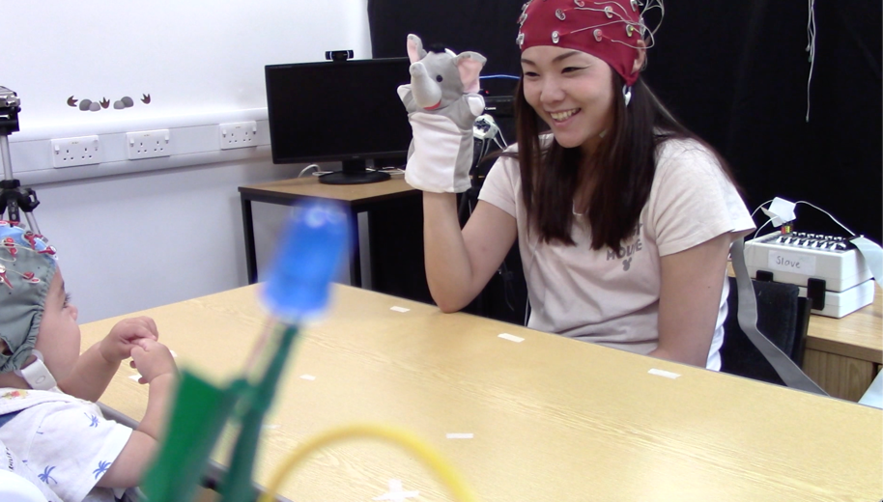
Researchers who study two parent child neural entrainment are typically interested in associations between oscillatory brain activity
Notes:
So identifying second type of brain activity and associating these

Slide 4
Focus on linking associations in brain rhythms (mostly in theta and alpha) to various aspects of social interactions
But most of what we understand about how infants (and to a lesser degree adults) brains process the environment comes from ERP research (first type).
Notes:
Any model of how two brains synchronize must reconcile these

Slide 5
This shift away from un ecological, screen-based assessments of social cognition has led to the use of more naturalistic paradigms, assessing brain-behaviour and brain-brain associations across the dyad.

Slide 6
Problems associated with naturalistic data collections and analysis

Slide 7
1. Increased movement within the simulation.
Signals generated from movement patterns, such as smiling, vocalisations, eye movements, as well as from the neural processing of each of these behaviours, will contribute to the scalp EEG in an unknown way.
Using ICA (more on this in workshop) maybe beneficial here, although this method isn’t perfect.
For example, artifacts can be trickier/ less reliable identified in infant vs adult ICA decompositions.

Slide 8
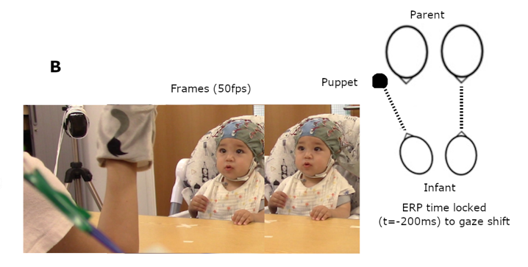
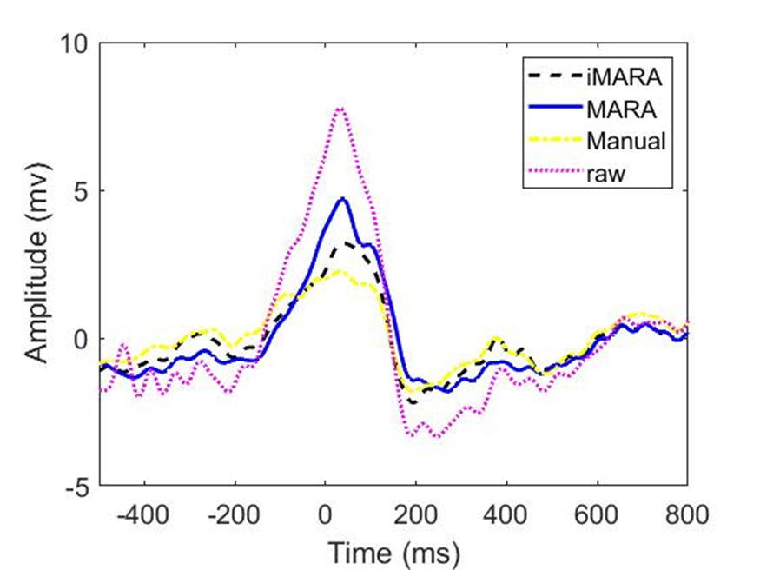
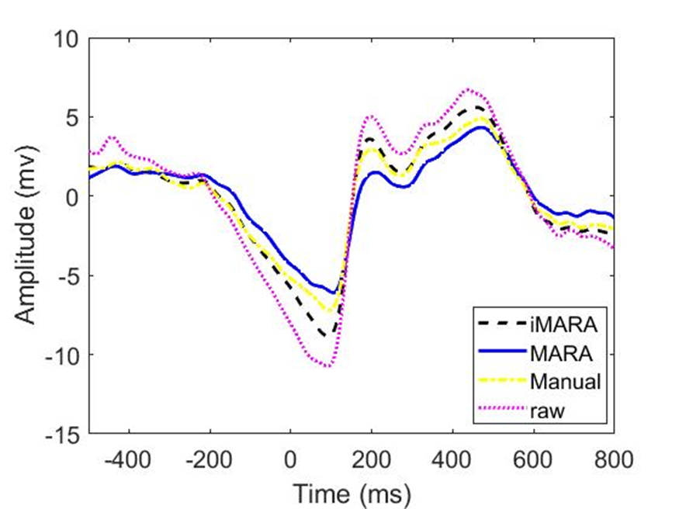
2 – during naturalistic/free viewing paradigms eye movements are time locked.
Frontal
Occipital
Problem: Compared to screen-based tasks our data is time locked to artifact e.g the movement of the eyes
Solution: More work on optimization of source separation techniques with child/infant EEG.
Notes:
The future study of IBC using naturalistic paradigms will need to control for the contributions of non-neural signal in the EEG. It may also treat this non-neural signal as a data source, by looking at synchrony between these movement-related signals, e.g., synchrony in EMG association with facial affect and vocalisations.

Slide 9
3. intrinsic differences in child vs adult EEG
For example, we know that the speed at which a brain will process information depends on maturation (e.g., Taylor et al., 2004)
Typical frequency bands in child/infant EEG are typically slower than that of adult EEG (e.g., Marshall et al., 2002).
Problem for developmental researcher’s interested in child adult neural entrainment.
Could use cross-frequency connectivity methods (Noreika, et al 2020) (more detail in workshop).

Slide 10
Section two: Overview of different ways of measuring inter-brain entrainment (IBE)

Slide 11
Different signal properties
Frequency
How fast?
Phase
Where?
e.g.,
‘theta’
4-8Hz
Power
How strong?
Important to note as different types of entrainment can/ are applied to different aspects of signal

Slide 12
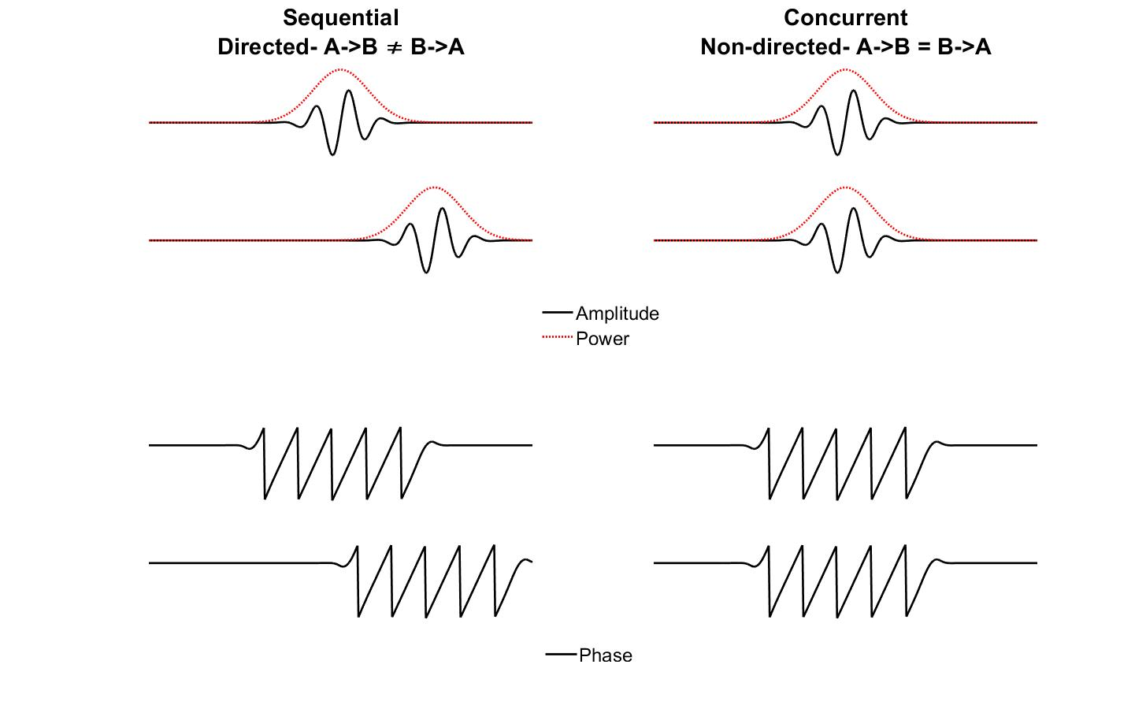
2. Overview of different ways of measuring inter-brain entrainment (IBE)
Notes:
Entrainment here refers to any temporally coordinated relationship between two signals.

Slide 13
Inter-brain entrainment (IBE) can, be measured in two ways.
First, concurrent IBE indexes a zero-lag, simultaneous relationship: ‘at times when A is high, B is also high’ or (for a negative relationship): ‘at times when A is high, B is low’. Concurrent IBE is often referred to using the term ‘synchrony’, and is undirected: A->B is indistinguishable from B->A.
Second, sequential IBE indexes a lagged, or temporally oriented relationship: ‘changes in A forward-predict changes in B’. Sequential IBE is directed, and as such, unlike concurrent coupling, it can be asymmetrical: it can be true that A forward predicts B without it being true that B forwards-predicts A, and vice versa.

Slide 14
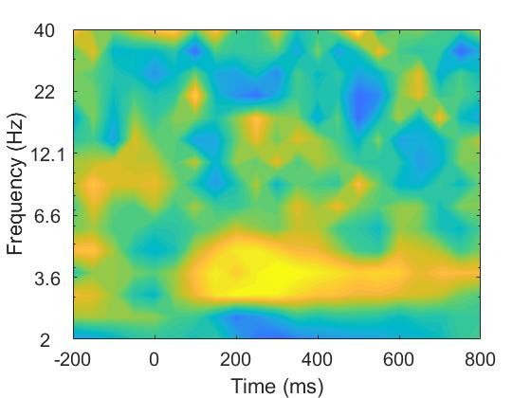
2.1 Measuring concurrent IBE of amplitude and power: correlations.
Notes:
Examining concurrent IBE through correlations is one of the simplest and most flexible techniques. Zero-lag concurrent IBE can simply be measured by calculating correlation coefficients between two time series. Spearman’s correlation is generally favoured due to its invariance to non-normally distributed and outlier prone data (Cohen, 2014). The same analysis can be applied either to the amplitude of the brain signal or to the power in particular frequency bands. The accompanying code for this section allows the reader to compute single-trial correlations (Spearman’s rho) at each time-frequency point, between pairs of electrodes (e.g., using data from Cz from person one and Cz from person two).

Slide 15
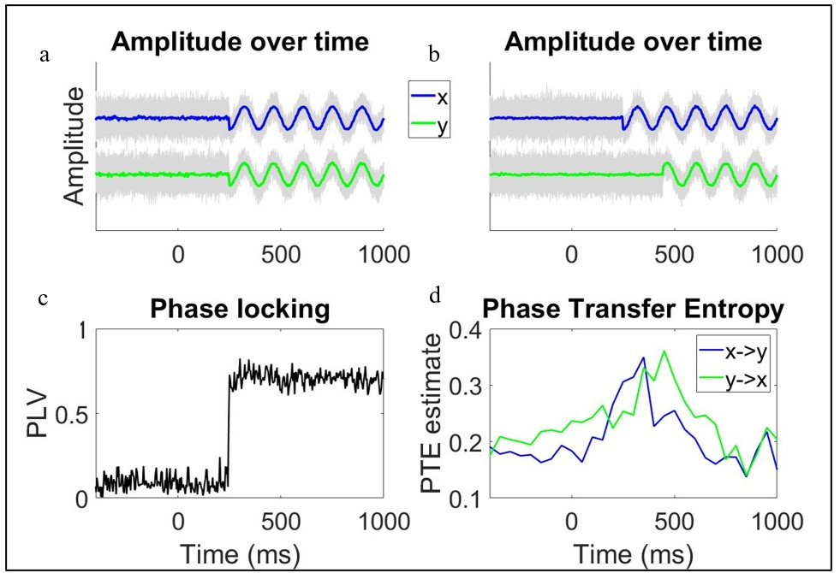
2.2 Measuring concurrent IBE of phase: ITC and Phase Locking Value (PLV)

Slide 16
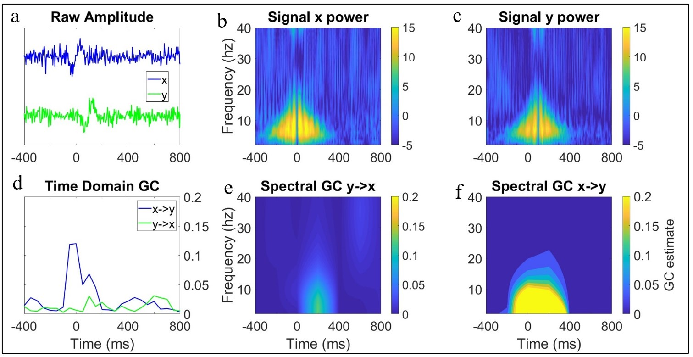
2.3 Measuring sequential IBE of amplitude and power – Granger Causality (GC)

Slide 17
2.4 Measuring sequential IBE of phase – Phase Transfer Entropy (PTE)

Slide 18
Section 3. Outstanding issues with measuring child adult neural entrainment

Slide 19
1. Shared entrainment to environment
How do we asses the live social determinants for IBE? For example, would you observe same level of IBE entrainment if both participants performed same task in isolation?

Slide 20
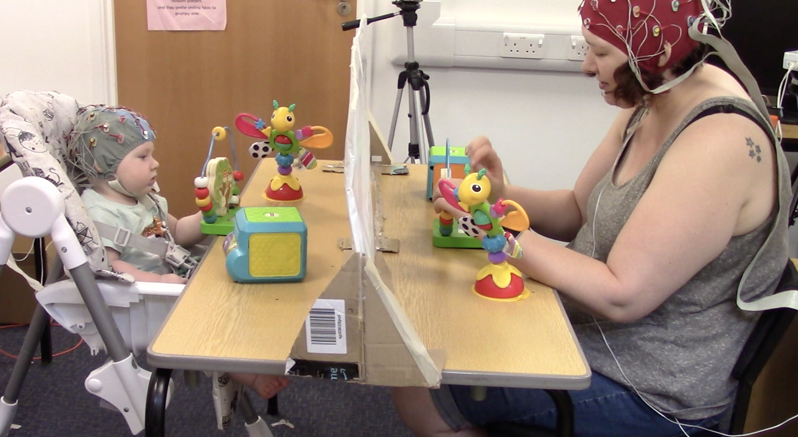
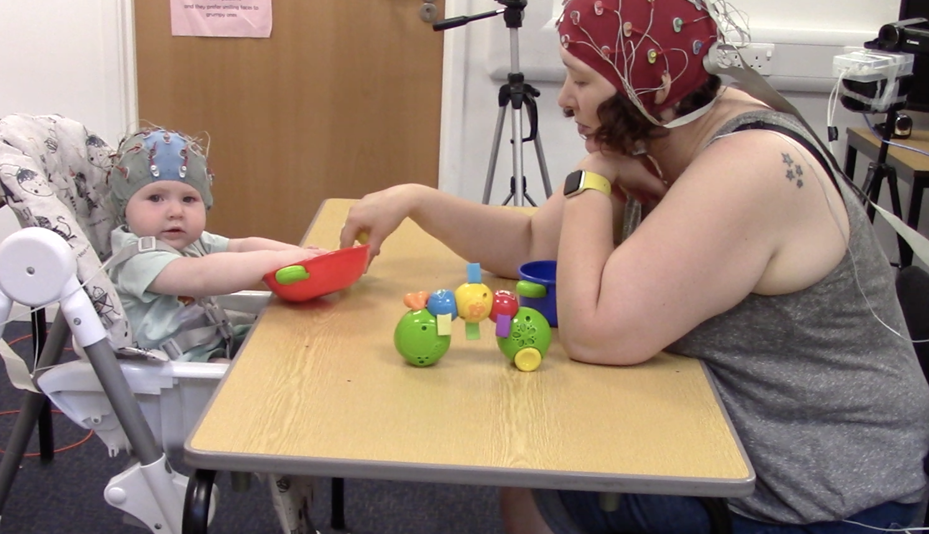
Solution: Study design

Slide 21
Solution: Focus on sequential

Slide 22
2. Considering events with different speeds
First, we are often considering events that have different periodic structures, and that unfold over different time scales.
For example, researchers might want to examine the relationship between eye gaze shifts (which take place every ~300ms – i.e., at ~3Hz), changes in autonomic arousal (between ~0.01and ~0.5Hz) and changes in EEG (between ~2Hz-~30Hz).

Slide 23
Solutions
Can look at this using temporal correlations in power at different frequencies and cross-frequency PLV – we have not discussed other approaches, such as phase-amplitude coupling (Canolty & Knight, 2010; Tort et al., 2010) that would also be useful (more in workshop).

Slide 24
Focus on bivariate behaviours
Research typically focus exclusivity on IBE in relation to bivariate behaviours.
Real social interactions involve highly layered and complex sequences of multimodal events that can unfold over multiple time scales in a continuous and interdependent way.
Future work will require more advanced data analysis to explore IBE in relation to more complex multivariate behavioural datasets.

Slide 25
Conclusion
Using dual EEG to assess social cognition is an interesting and exciting field with lots of promise- but dual EEG data collection around naturalistic paradigms can be tricky.
Exploring inter brain entrainment of oscillatory activity is one way we might look at how the brain supports real contingent social interactions.
This can be explored using different techniques and aspects of the EEG signal.

